Slide 1
Efficient and Correct execution of parallel programs that share memory
孙志航

Slide 2
Sequential consistency
The most common memory model
If access u appears before v in the same thread, every execution path guarentees u executes before v
But how to enforce a sequential consistency, especially when memory accesses can be pipelined?

Slide 3
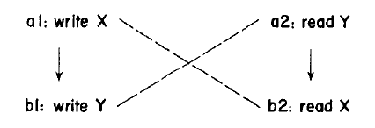
DEFINITIONS
Memory accesses are ordered as a graph, to which several relations are applied

Slide 4
DEFINITIONS: PROGRAM ORDER
(P)rogram order: an intraprocess irreflexive, asymmetric, transitive relation
referred to as directed edges on the graph

Slide 5
DEFINITIONS: CONFLICT
(C)onflict: an irreflexive, symmetric relationship
u and v conflict if they access the same location and at least one is WRITE
referred to as undirected edges on the graph

Slide 6
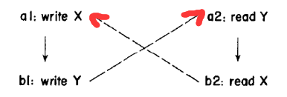
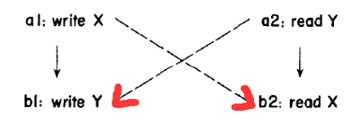
DEFINITIONS: EXECUTION ORDER
(E)xecution order
An execution order is an orientation of Conflict relation

Slide 7

DEFINITIONS: CONSISTENCY
E is consistent with P if E can be extended to a total order $\overline{E}$ so that $P⊆\overline{E}$
iff $E∪P$ is acyclic

Slide 8
ATOMICITY
Accesses of an atomic operation execute consecutively in an execution path
Usually implemented based on lock, but this paper proposes a lock-free method

Slide 9
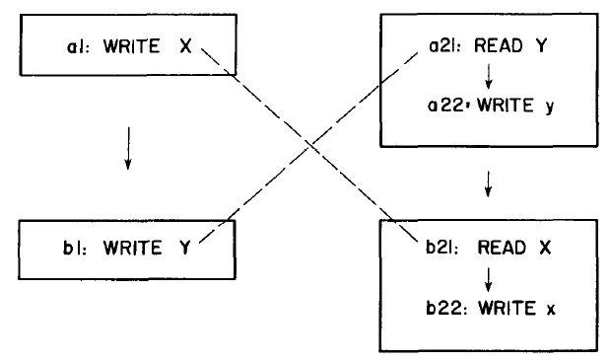

DEFINITIONS: ATOMICITY
(A)tomicity: an equivalence relation
Frames shows equivalence classes divided by A
P is closed under A
if $(u, v)∈P$ and u not equivalent to v,
for each u’ equivalent to u
and each v’ equivalent to v
$(u′, v′)∈P$

Slide 10

DEFINITIONS: CONSISTENCY WITH ATOMICITY
E is consistent with P and A if E can be extended to a total order $\overline{E}$ so that $P⊆\overline{E}$, and equivalent elements defined by A occur consecutively in $\overline{E}$
iff $E∪P$ is acyclic and E/A $∪$ P/A is acyclic

Slide 11

DefinitionS: What do we expect?
(D)elay: irreflexive, asymmetric, transitive relation
if $(u,v)∈D$, the processor will prevent v from executing until u ends
A set D is valid if for any E consistent with D, E is consistent with P(and A)
a valid D not necessarily enforces SC but outcome is equivalent
P(program order) is trivially a valid D but too complicated
we need a minimal valid D

Slide 12

D construction without atomicity
A valid D should not set any inconsistency undetected
Inconsistency = $E∪P$ contains cycle
Find potential cycles and prevent it!

Slide 13
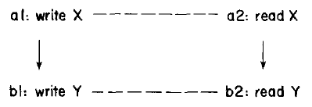
D construction without atomicity
Consider mixture of P edges of C edges:
if an orientation of C forms a cycle, it is a potential cycle of (P, C)
P edges of a potential cycle is important, if D leave out such edges, D won’t be able to detect this potential cycle.

Slide 14

D construction without atomicity
Only critical potential cycles are considered
Critical potential cycles are simple and have no P chords
For each E inconsistent with P(so that $E∪P$ contains cycle), the cycle can be reduced to a critical cycle
that is, if D detects critical cycles, it detects all E inconsistent with P
Critical edges are P edges that appear in critical cycles
D consists of critical edges

Slide 15

HOW TO IDENTIFY A CRITICAL CYCLE
A cycle is critical iff:
The cycle contains at most 2 accesses from one thread, and they appear successively
The cycle contains 0, 2 or 3 accesses to any variable, they appear successively
For 2 accesses, write->read, write->write, read->write are all possible
For 3 accesses, only read->write->read

Slide 16
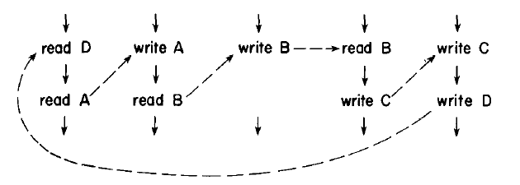
A TYPICAL CRITICAL CYCLE

Slide 17
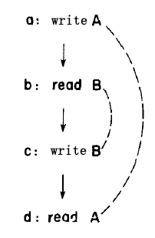
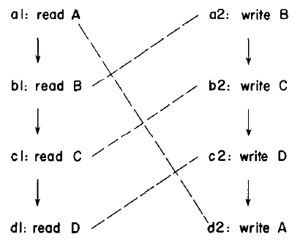
EXAMPLES

Slide 18
D construction with atomicity
E is consistent with P and A iff
E is consistent with P (solved) and E/A is consistent with P/A
How to find critical cycles of (E/A, P/A)?

Slide 19

D construction with atomicity
Projection of cycle c on A(an equivalent relation):
replace any access of c with its equivalence class, then remove self cycles
Any critical cycle c of ($P∪A, C−A$)’s projection is a critical cycle c’ of (P/A, C/A)
Any critical cycle c’ of (P/A, C/A) is a projection of a critical cycle c of ($P∪A, C−A$)
We only need to identify critical cycles of ($P∪A, C−A$)

Slide 20
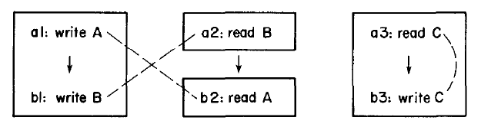
An EXAMPLE

Slide 21
EXTENSION: CONSIDER BRANCHES & LOOPS
When a thread consists of more than one basic blocks…
Add a fence at the entry of each basic block

Slide 22

EXTENSION: CONSIDER BRANCHES & LOOPS
When loops exist, P itself is a cycle $(u, u)∈P$
one access has several instances,
$(u, v)∈P$: there exist one instance of u, prior to one instance of v
we still find critical cycles of (P, C)
critical cycles under this circumstance have the same properties

Slide 23
THANKS FOR YOUR ATTENTION!

